Slide 1


Team 42: Multi-Axis Cobot for Factory Automation
Bi-Weekly Update 4 Emily Hamsa, Ethan Woods, Adrian Guzman, Jaishil Shah
Sponsor: Will Hofstetter
TA: Vishwam Raval
Notes:
Michelle

Slide 2

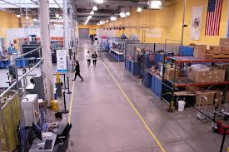
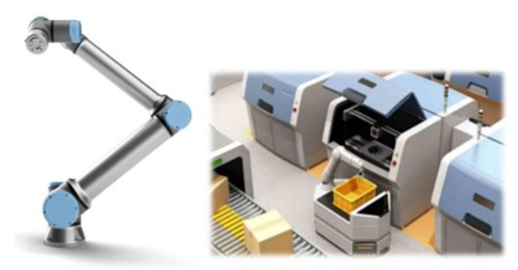
Project Summary
Problem statement:
Factory settings pose dangerous environments to human workers through the exposure to heavy machinery, tight spaces, and repetitive workloads. These hazards increase chance of injury and worker burnout. We need to implement collaborative robots (Cobots) to improve worker conditions.
Human Injury & Burnout in Warehouses
Cobot Solution
Notes:
Adrian

Slide 3
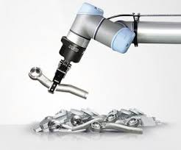
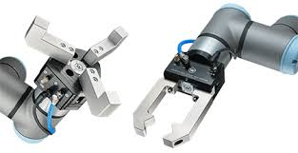
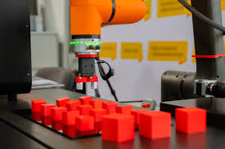
Project Summary
Solution proposal:
Develop a Cobot that can integrate into a factory environment to reduce human injury, worker burnout, and increase productivity in repetitive tasks. The Cobot shall be able to lift (1-2 lbs) and be placed into tight environments and controlled wirelessly through mobile app.
Repetitive Tasks
1-2 lbs. Load
Precise Control
Notes:
Ethan

Slide 4
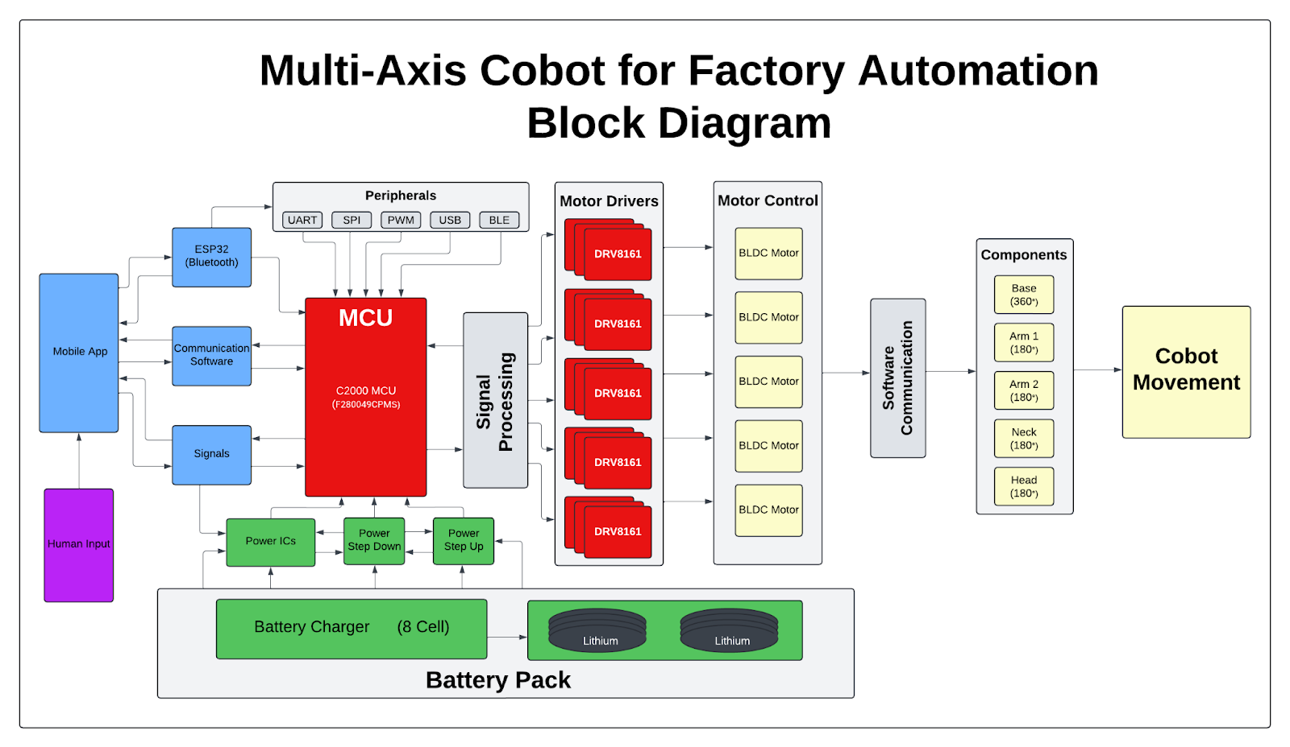
Project/Subsystem Overview
Adrian
Ethan
Jaishil
Emily
Subsystem Diagram Color: Power, MCU/Connectivity, Mobile App, Motor Control

Slide 5
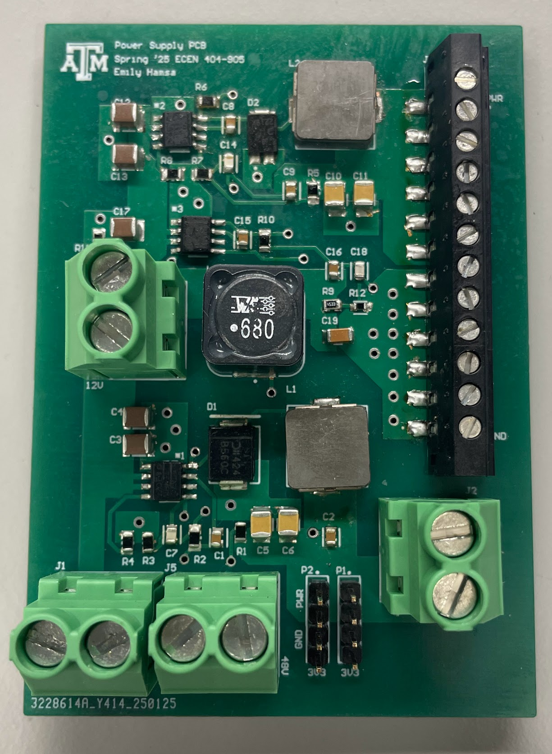
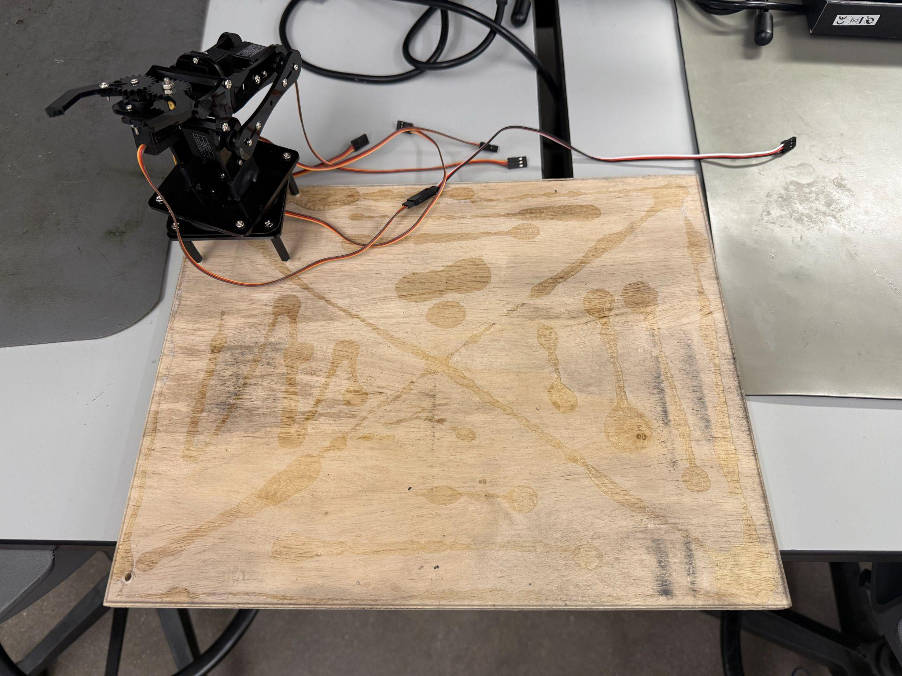
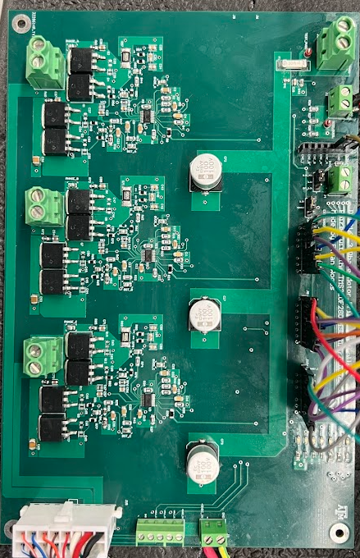
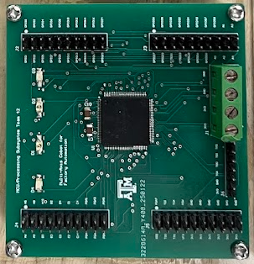
Integrated System Diagram
Power PCB
Platform
Motor Driver PCB
MCU PCB x2

Slide 6
Project Timeline
Review/update progress since E403
Team finalizing design of new PCBs
Order PCB and components
Conversation over physical structure of cobot arm…(Amazon purchase with 1x BLDC motor and 3x-4x Servo)
Team is fixing issues with integration between subsystems
Reviewing bugs/fixing problems
Cobot arm should have clear path and deliverables
Team is fully integrated and operational
Cobot arm is moving
Fix issues with accuracy and movement of arm
Update #2 (Feb 3)
Update #4 (Mar 3)
Final #6 (Apr 7)
Update #1 (Jan 15)
Update #3 (Feb 17)
Update #5 (Mar 24)
Finish putting together new generation boards
Test and validate to ensure functionality
Cobot arm delivered and brainstorm ideas
Integration should be nearing completion
Cobot arm is revamped and near operation
Issues should be resolved with subsystems
Cobot arm is working as expected and can pick up objects that meet the restrictions
Team is making project look visually appealing
Cosmetic touch ups
Notes:
Required:
High level figure showing where you are at in the project, what’s completed, what’s underway – it should take about 30 seconds to summarize where you are in the timeline
-- Save discussion for subsystem update
-- Save detail for execution plan & validation plan status

Slide 7
Motor/Motor Driver Subsystem
Ethan Woods
Accomplishments since last update 10 hrs of effort | Ongoing progress/problems and plans until the next presentation
Motor Driver Subsystem Completed Completed Research on Motor Mounting Hub Ordered Universal Mounting Hub to integrate BLDC Motor into Cobot Frame Shipped last Tuesday.. not arrived Precise Movement Control Tested and verified Encoder feedback to understand how it can be precisely controlled. Continued assistance with integration of the Motor into MCU Subsystem and Cobot structure | Once the Motor Mounting Hub arrives, Fit Mounting Hub onto NEMA 23 BLDC Motor and prepare for integration Integration onto Cobot involves attaching Mounting Hub to a rotating bearing plate and securing the motor to the base/structure Continued Precise Movement Control, Create and design scheme to control the rotational limits (for no tangled wires) using Encoder feedback. Will be integrated with the Wireless Connectivity Subsystem Once motor is mounted, determine the best duty cycle % and understand how load affects the current draw. (No load/free rotation at 8% = .4 A) Continued Integration into Cobot Structure
Notes:
This should not be just subsystem status! At this point it should be review of the System Integration and Test activities led by Team Member 1
For 4th review Accomplishments should include what integration and functional/range/error system testing completed and planned for next 2 weeks”
“Completed integration of all subsystems”
“Verified sensor data capture and communication through Bluetooth to App”
“Integrated image detection model on Pi-4 on drone, tested detection accuracy”
“Tested app error handling for stuck valve & thermal range exceeded cases”
“ON-GOING automated software testing”
“Range testing of LoRa network from 10m to 5km with 35 points in BCS”
“Rover motor stall test with 2x max payload and 40º elevation by next review”

Slide 8
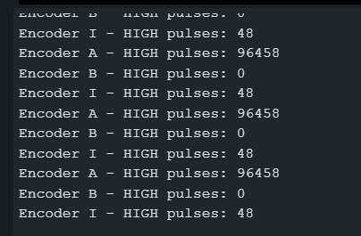
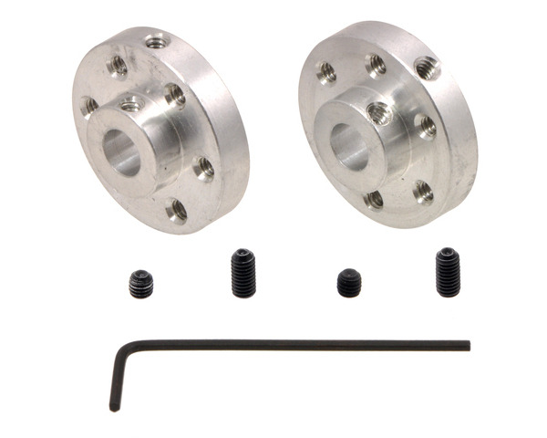
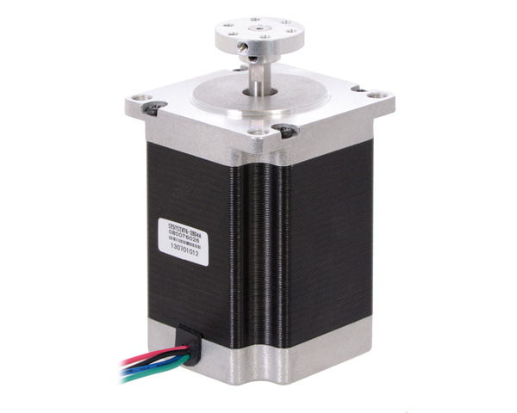
Motor/Motor Driver Subsystem
Ethan Woods
Precise Movement Control Through Encoder:
Differential Encoder at 8000 counts/rev (ENC A,A~,B,B~,I)
2000 counts/rev per ENC A,A~,B,B~
1 count/rev for ENC I (full rotation)
Using Encoder A, define a working operation range for the rotation of Cobot.
Starting facing front, no more than 90° in either direction (left or right)
Theorized plan for integration:
Beginning at 0 ENC A pulses, no more than 500-1000 counts in either direction.
Movement becomes locked once the threshold is reached
Possible TOTAL count tracker, where total count = right count + left count to ensure no over-rotation at MAX TOTAL count
Encoder count after 48 revolutions (48 * 2000 = 96000):
Motor Mounting Hub (Mounts to TOP of Motor Shaft):
Specifications: 25.4 mm (1 in) diameter x 9.2 mm thick
Motor Mounting Process:
As of now, to mount the motor:
The Mounting Hub will attach/screw into a rotating bearing plate, which will act as the base for the arm of the Cobot
Motor will be screwed into plate below rotating bearing and adhered onto the base board (Velcro most likely option)
Notes:
This should all be test results! – show things working, functional test results, error checking, etc
Show test results for integrated systems

Slide 9
MCU/Processing Subsystem
Adrian Guzman
Accomplishments since last update 10 hrs of effort | Ongoing progress/problems and plans until the next presentation
Full MCU Integration Complete Motor Driver & BLDC Software implementation to control BLDC motor for left & right motion BLDC motion tested using buttons for control With BLDC motor now operational and previous wireless connectivity functional, the MCU subsystem has fulfilled all requirements. Layout of PCBs on platform Obtained PCB standoffs for mounting and clean appearance Added additional information to mobile app | Help team implement the following Attach BLDC motor to bottom of cobot Finalize the new cobot build Attach PCBs to acrylic platform Connect all systems, confirm functionality, and tidy up wiring Refine mobile application As a team we are aiming to get everything working and placed on the platform by the end of capstone Blitz weekend.

Slide 10
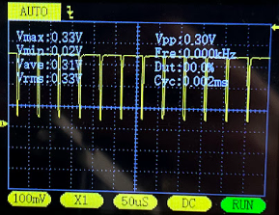
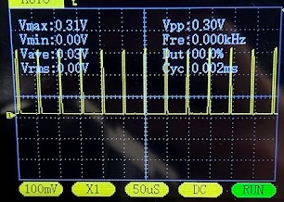
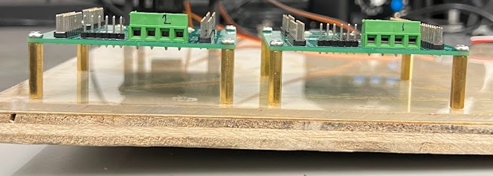
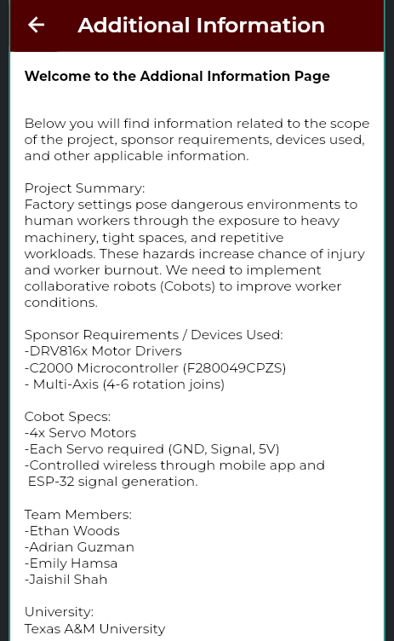
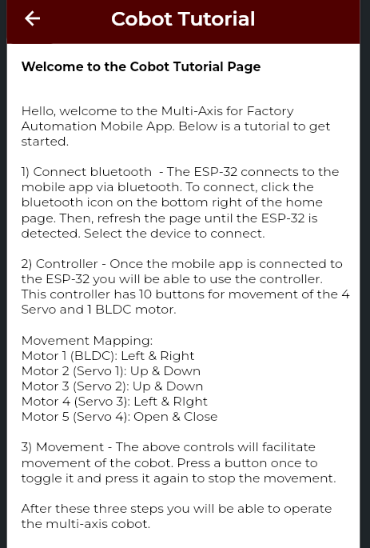
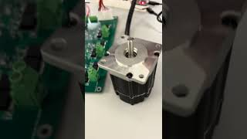
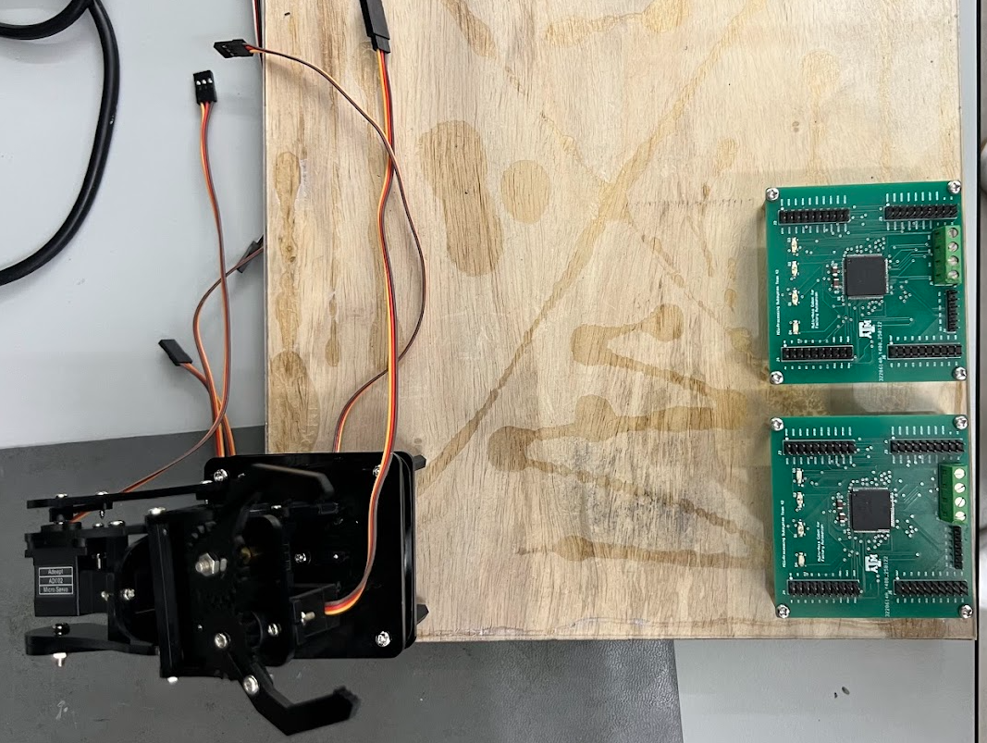
MCU/Processing Subsystem
Adrian Guzman
Risers will be used on all PCBs to provide a cleaner look, as well as give space for cable management underneath.
PWM6A
PWM6B
Side View Layout
BLDC Control Video
Created Tutorial & Additional Information Page for mobile app
Top View Layout

Slide 11
Power Management
Emily Hamsa
This should not be just subsystem status!
At this point it should be review of the System Integration and Test activities led by Team Member 1
Accomplishments since last update 10 hrs of effort | Ongoing progress/problems and plans until the next presentation
Validated the PCB can handle load at full input using an Electronic DC Load Used load expectations from datasheets to ensure PCB can support fully integrated cobot Validated noise at output is acceptable Some noise is present, but not cause for concern Worked on physical design Glued acrylic and wood together and mounted cobot to base | Research and implement fuse at input for system protection Validate operation using battery Continue work on physical design Mount boards and continue modifications for the motor Work on full integration
For 4th review Accomplishments should include what integration and functional/range/error system testing completed and planned for next 2 weeks”
“Completed integration of all subsystems”
“Verified sensor data capture and communication through Bluetooth to App”
“Integrated image detection model on Pi-4 on drone, tested detection accuracy”
“Tested app error handling for stuck valve & thermal range exceeded cases”
“ON-GOING automated software testing”
“Range testing of LoRa network from 10m to 5km with 35 points in BCS”
“Rover motor stall test with 2x max payload and 40º elevation by next review”

Slide 12
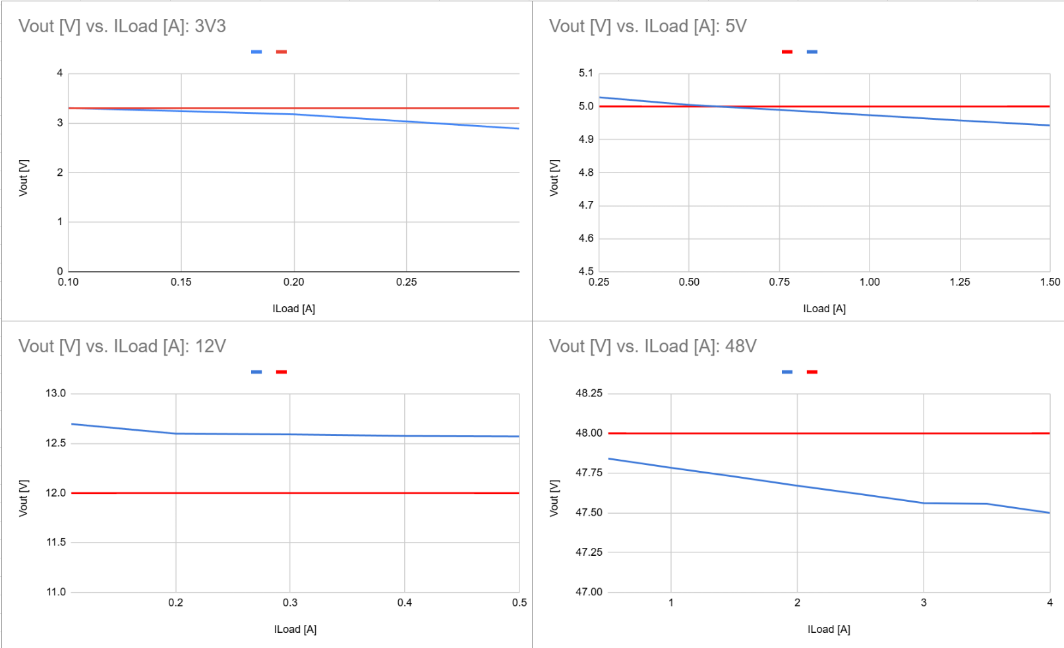
E-Load Testing:
Red: Shows the desired value of the output
Blue: Shows the output as the load is increased
Some decrease in the output is expected, and overall the decrease is within acceptable bounds.

Slide 13
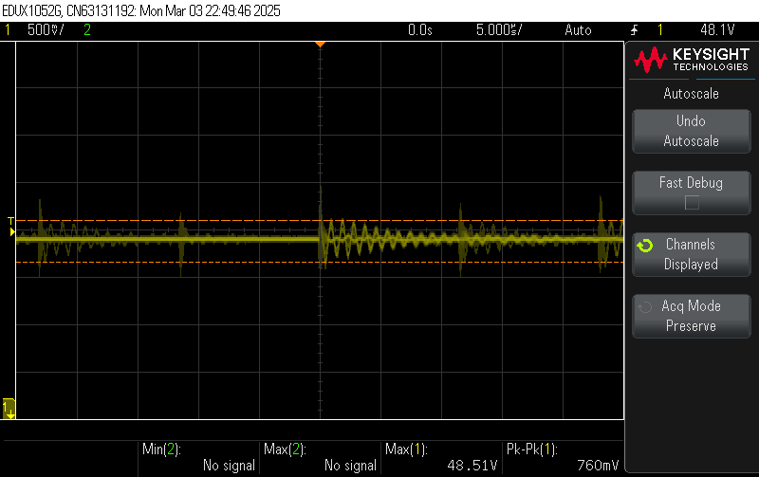
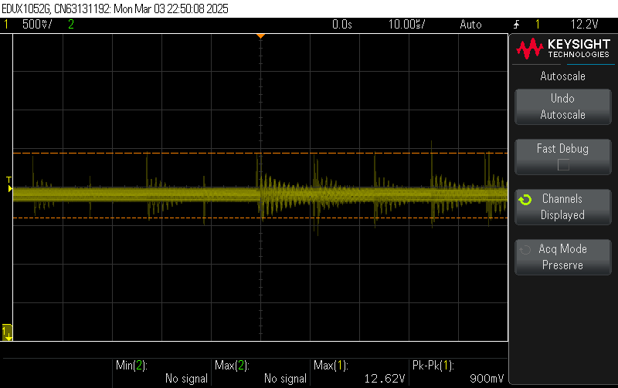
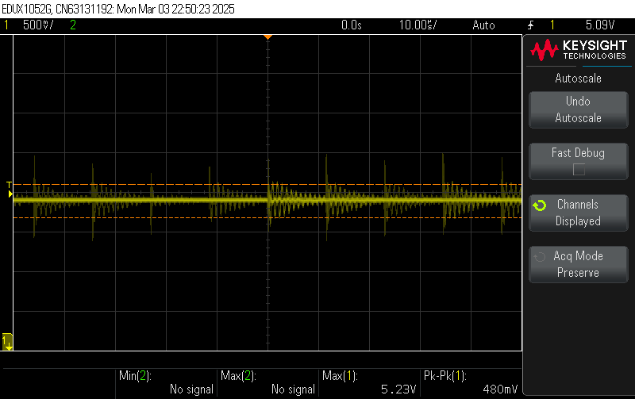
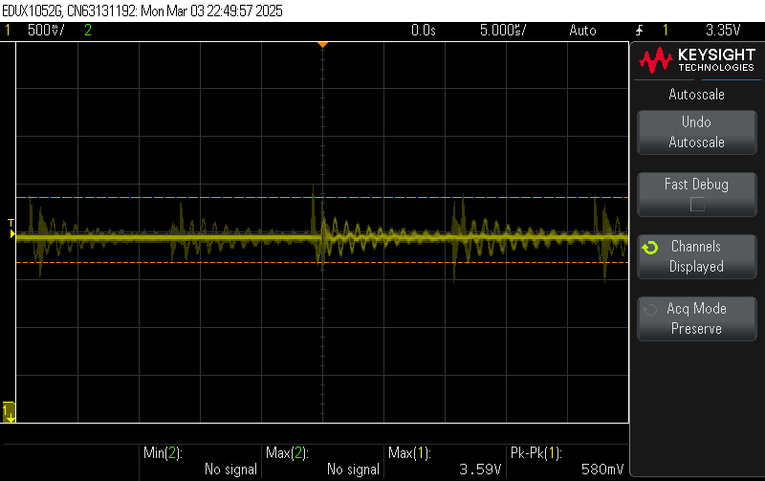
DC Output Testing:
Some noise is present at the output of the terminals, but majority of the output is within an acceptable margin.
48V Output: 760 mV Peak to Peak
12V Output: 900 mV Peak to Peak,
5V Output: 480 mV Peak to Peak
3V3 Output: 580 mV Peak to Peak

Slide 14
UI/Wireless Connectivity Subsystem
Jaishil Shah
Accomplishments since last update 10 hrs of effort | Ongoing progress/problems and plans until the next presentation
- Successfully mounted Cobot onto physical apparatus - Confirmed all individual subsystems are ready for integration - Added complexity and changes to mobile application - Order and completed plan for physical assembly of all parts | - Mounting PCBs onto physical apparatus - Accomplish wireless communication with the BLDC motors - Power the ESP-32 via Power Supply - Test encoder and create fault detection system - Once parts come in, complete assembly of the final design

Slide 15
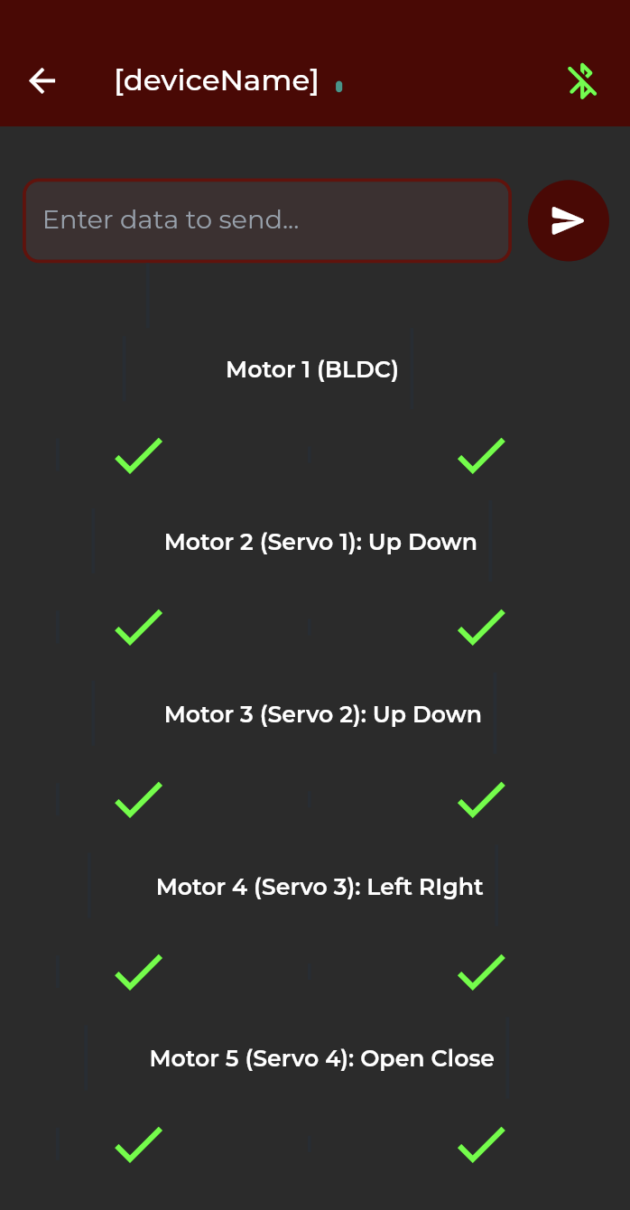
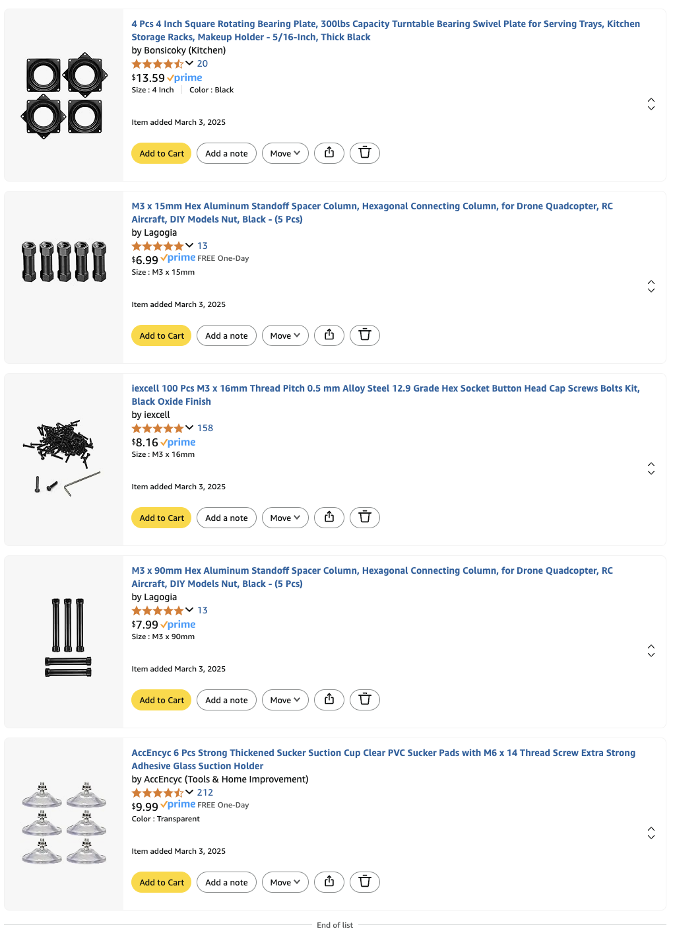
UI/Wireless Connectivity Subsystem
Jaishil Shah

Slide 16
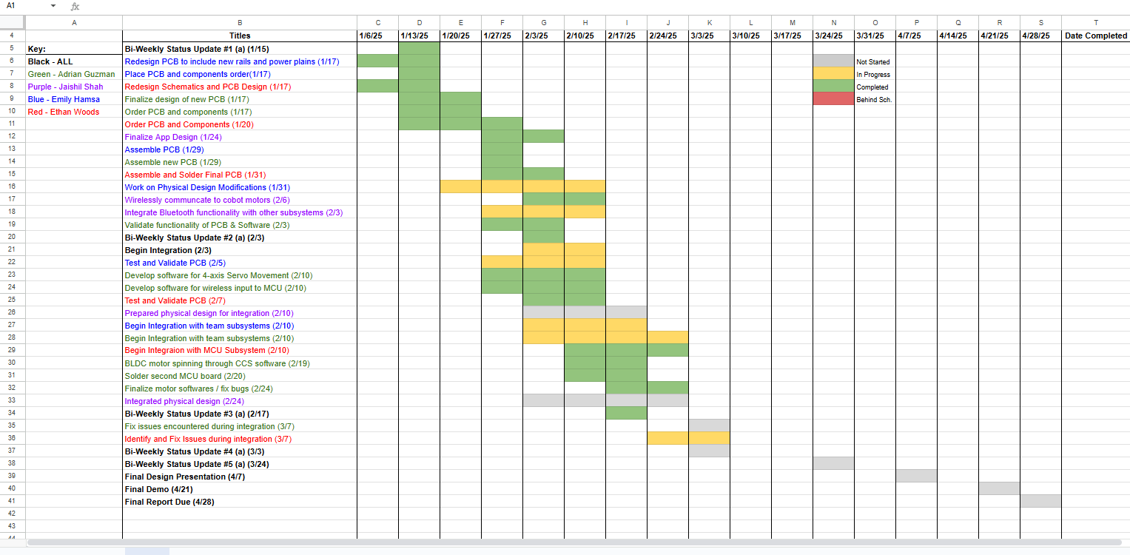
Execution Plan
Notes:
Michelle

Slide 17
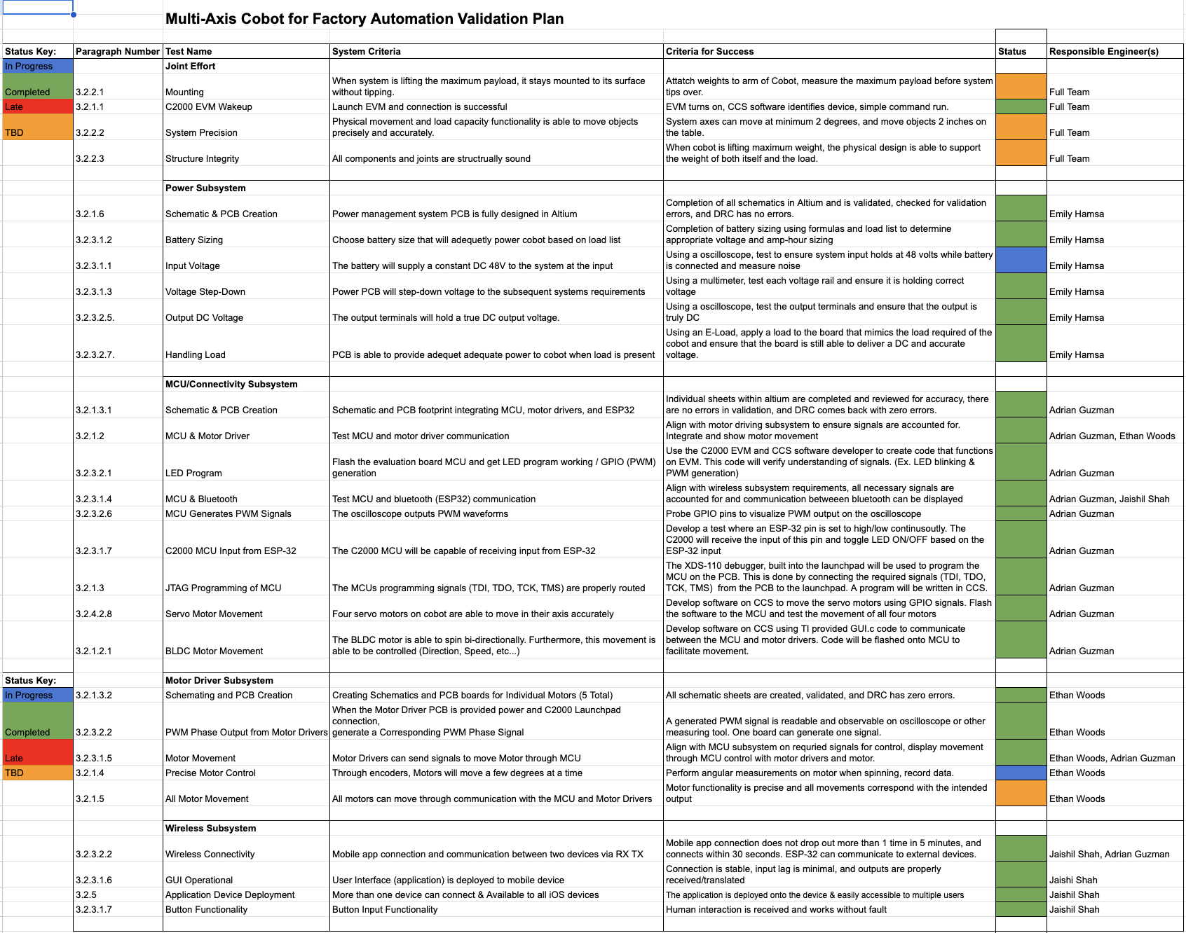
Validation Plan
Notes:
Michelle

Slide 18
Thank You!

